Slide 1

Structured approach to prepare for Android Interviews
By: Gaurav Bhatnagar

Slide 2
Agenda
Data structure questions (CS fundamentals)
Core Java and collections related questions
Core Android platform related questions
Details about the Activity and Fragment Lifecycle
Details about all the Android Application Components
UI Concepts
Fragments
Concepts of Local Storage.
Broadcast receivers.
How to handle background work
Tools used for building apps and 3rd party libraries
Notifications
Tips to improving productivity in android development

Slide 3
Data structure (1/3)
Array
Linked List
Doubly Linked List
Stack
Trees & Graphs
Solving problems related to Binary Search Tree.
Sorting Algorithms
Bubble sort
Selection sort
Merge Sort
Insertion Sort
Quick Sort
Heap Sort
Puzzles related to sorting algo or different data structures specified above.

Slide 4
Data structure (2/3)
Problem Solving :
Reverse an Array
Find the second last element in the linked list.
How does the Doubly linked list behaves ?
an array of size n with range of numbers from 1 to n+1. No duplicates, however one number is missing, find the missing number.
We require to understand how to compare the performance of different algorithms and choose the best one
Time complexity of an algorithm quantifies the amount of time taken by an algorithm to run as a function of the length of the input. (source : https://www.hackerearth.com/)
Space complexity of an algorithm quantifies the amount of space/memory taken by an algorithm to run as a function of the length of the input. (source : https://www.hackerearth.com/)

Slide 5
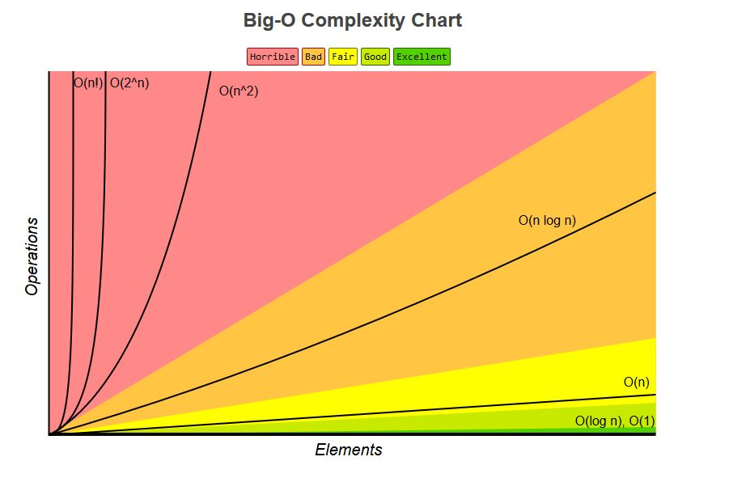
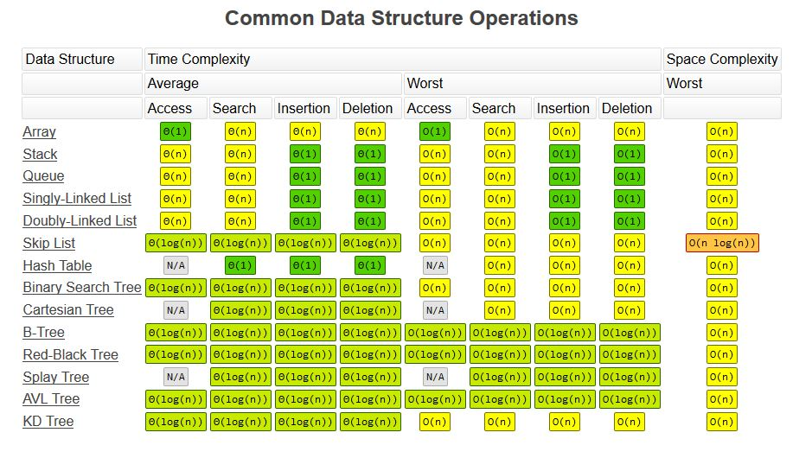
Data structure (3/3)
Source: http://bigocheatsheet.com/

Slide 6
Core Java questions(1/2)
OOPS Concepts
Classes & Objects
Polymorphism, Abstraction ,Inheritance and encapsulation.
Overloading & Overriding.
Static and Dynamic Binding.
String Handling Questions
Difference between == & .equals on a string.
Difference between equalsIgnoreCase and contentequals().
Why string is immutable
Difference between String s1 = “ignore” and s1 = new String(“ignore”)
Difference between String builder and String buffer.

Slide 7
Core Java questions(2/2)
Different Keywords in Java
Static block, method and variables.
Final, finally and finalize
Transient and volatile
Synchronized
Private, protected and public.
Primitives
What are the 8 primitives in Java
What is auto-boxing and unboxing
What is difference between int and Integer
What is the memory required for int and Integer
How does the garbage collector works?
Is Java pass by value or pass by reference? Explain in detail.
Concurrency in Java.
What is synchronization ? How does joins work
How does join work.
What is wait(), notify() , thread priority .
Difference between Runnable interface and creating a thread subclass.

Slide 8
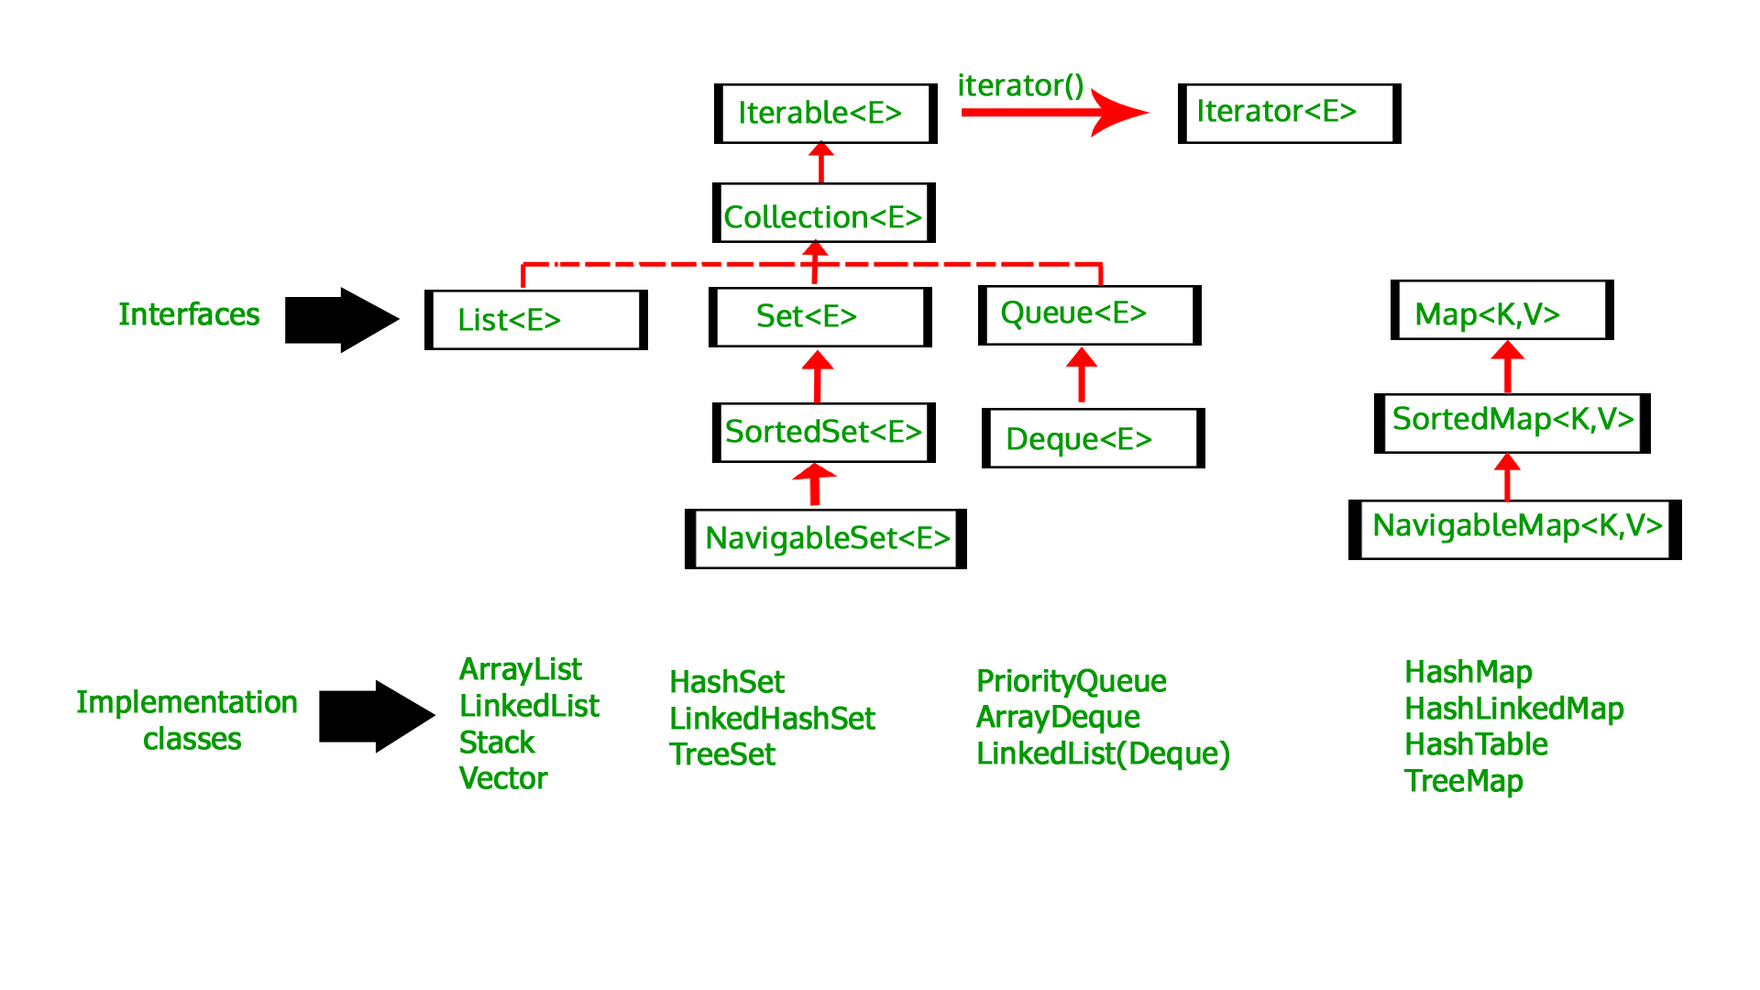
Core Java collections (1/2)
Source : https://www.geeksforgeeks.org/
Difference between TreeSet and HashSet
Difference between HashMap , ArrayMap & SparseArray
How does the HashMap works internally
Difference between ArrayList and Vector.
How can the HashMap work with multiple threads.
Difference between Enumeration and Iterator

Slide 9
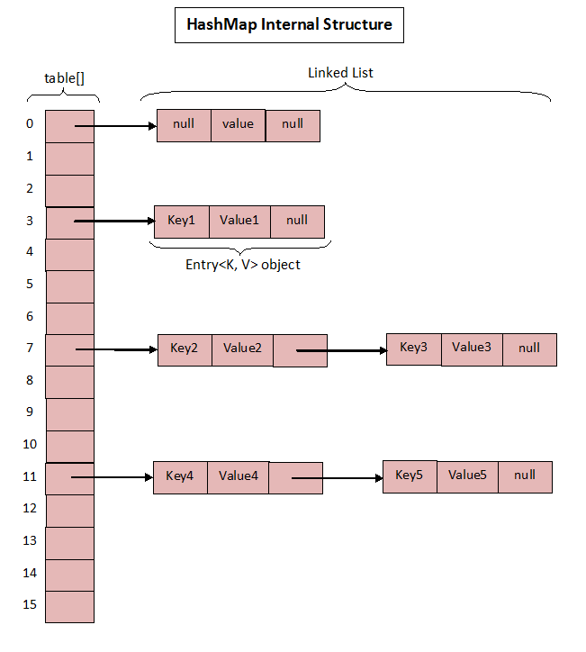
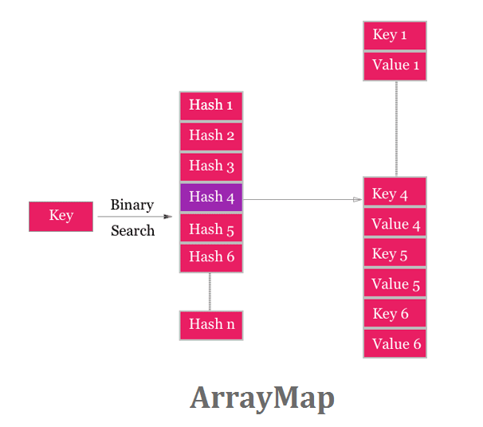
Core Java collections (2/2)
Source : http://javaconceptoftheday.com/how-hashmap-works-internally-in-java/
https://android.jlelse.eu/
HashMap is basically an Array of HashMap.Entry objects (Entry is an inner class of HashMap). On a high-level, the instance variables in Entry class are :
A non-primitive key
A non-primitive value
Hashcode of the object
A pointer to next Entry
ArrayMap uses 2 arrays. The First Array comprises of the hashes for the keys in the sorted manner. The second array is the Key-Value array. When an key/value is inserted :
Key/Value is autoboxed.
Key object is inserted at the next available position in mArray[ ].
Value object is also inserted in the position next to key’s position in mArray[ ].
The hashCode of key is calculated and placed in mHashes[ ] at the next available position.

Slide 10
Design Patterns
Creational Design patterns define the mechanism of creating objects for designing solution :
Factory Method Pattern
Abstract Factory Pattern
Singleton Pattern
Prototype Pattern
Builder Pattern
Object Pool Pattern
Structural Patterns
Adapter, Decorator and Façade patterns
Behavioral Design patterns
Chain of responsibility ,Iterator or Strategy.

Slide 11
Core Android questions (1/5)
Details about the Activity and Fragment Lifecycle
Is the restart method an override method?
When does the onSaveInstanceState() method get called?
Where to persist the data when back button is pressed or orientation change happens ?
Activity and Application Context.
Details about PIP and multi-window mode **
Explain about task affinity flag **
Excellent Resource how the activity and fragment lifecycle behaves :
https://medium.com/google-developers/the-android-lifecycle-cheat-sheet-part-i-single-activities-e49fd3d202ab
Details about all the Android Application Components.
Content Provider
Broadcast Receivers
Services
SQLite DB
Intents (Implicit and Explicit) + launch-modes
** Mid & Senior Level

Slide 12
Core Android questions (2/5)
UI CONCEPTS IN ANDROID
What is View in Android? Concepts of Layouts
Difference between Alert Dialog and a normal Dialog?
Difference between View. GONE and View. INVISIBLE?
How do you support different types of resolutions?
What is a spannable?**
What is the difference between ListView and RecyclerView? Explain the ViewHolder Pattern in detail.
What is the use of setHasFixedSize()**
How can we show cells comprising of different layouts in RecyclerView?
What is SnapHelper?**
How to provide clicklistener in RecyclerView.
What is Android Data Binding?**
How does the layout inspector works ?
How is Constraint Layout better than relative-layout ?**
** Mid & Senior Level

Slide 13
Core Android questions (3/5)
FRAGMENTS
How would you communicate between two Fragments? What is retained Fragment?
What is the difference between a fragment and an activity? Explain the relationship between the two.
Understanding Fragment Transactions
How the view-pagers can be used with the fragments.
How to preserve fragment state during orientation change? **
Concept of local storage
What is a ContentProvider and what is it typically used for?
How can we make the content-provider private.
What is ORM? How does it work?**
Explain about ROOM.**
Broadcast Receivers
What is a BroadcastReceiver?
What is a LocalBroadcastManager and how intents work to be able to pass messages around your app?
What is a PendingIntent ?
Describe how broadcasts work and What are the different types of Broadcasts?
How does the intent filter works ?
** Mid & Senior Level

Slide 14
Core Android questions (4/5)
HOW TO HANDLE BACKGROUND WORK IN ANDROID?
How would you perform a long-running operation in an application?
Why Bundle class is used for data passing and why cannot we use simple Map data structure?
What are the problems in asynctask and comparison with Java thread?
What is ANR? How can the ANR be prevented? Difference between Service and an Intent-Service
What are Job Schedulers and how are they better than Alarm Managers. **
Explain Looper, Handler and HandlerThread
How does the Loader mechanism works.
How does the android architecture components help in fixing this issue. **
What is AIDL? Enumerate the steps in creating a bounded service through AIDL**
** Mid & Senior Level

Slide 15
Core Android questions (5/5)
TOOLS USED FOR BUILDING APP AND 3rd PARTY LIBRARIES
What is the difference JVM, DVM and ART?**
Explain about support library?
Which libraries should be used for crash reporting and how can you force a crash ?
How can we find memory leaks in the application.**
How is Lint supposed to be used.
How does Fresco and Glide works internally.**
Difference between Retrofit and Volley?**
Should we use Butter-Knife or Data-Binding?**
NOTIFICATIOS AND HOW THEY MUST BE IMPLEMENTED
Notification Styles & customized UI
FCM vs GCM ?
Notification Channels
How to secure notification content?
** Mid & Senior Level

Slide 16
Tips for improving productivity in android development
Always use strings.xml
Always try to use data binding library.
Always secure the API Keys
Always required to consider activity life-cycle into account.
Always use Android studio shortcuts.
Placing the launcher icons in mip-map folders
Avoiding nested layouts.
Avoiding memory leaks by not using static contexts.
Avoid holding reference of views in background threads or in collections.
Avoid using static views.
Avoid using anonymous inner classes.
Never use views in collection.
Always write Unit tests.
Always use pro-guard and Lint tool to refactor and reduce duplicated dependencies.
Keep the code modular.

Slide 17
References :
https://www.linkedin.com/pulse/art-design-patterns-android-ahmed-iraki
https://eng.lyft.com/interviewing-tips-for-android-engineers-f01ce7fba163
https://github.com/MindorksOpenSource/android-interview-questions
https://blog.mindorks.com/android-development-best-practices-83c94b027fd3
https://medium.freecodecamp.org/first-5-mistakes-to-avoid-in-android-development-51177007a4f6
http://bigocheatsheet.com/
https://medium.com/mindorks/practical-data-structures-guide-for-android-developers-73fdec190802
https://www.hackerearth.com/practice/basic-programming/complexity-analysis/time-and-space-complexity/tutorial/
https://www.geeksforgeeks.org/collections-in-java-2/
https://mindorks.com/blog/detecting-and-fixing-memory-leaks-in-android

